Slide 1
Distributed Programming lecture 2
Andrea Valente
anva@mmmi.sdu.dk

Slide 2
Topics
Modeling data
Strings, mutable/immutable types
Array
Objects
Modeling and processing data
and arrays of objects

Slide 3
Modeling data
Example: the were-squirrel in ELO chpt 4
how to represent the journal?
(so that it is eays to extract information later? See later on)
Central question in data modeling:
what type of values to use to represent my problem’s variables?
So far we know: numbers (int and float), boolean values, string (like ”ape”) and special values undefined and null
Today we will cover more about strings, but also: arrays and objects

Slide 4
String
“… numbers, strings, and Booleans, are all immutable
You can combine them and derive new values from them, but when you take a specific string value, that value will always remain the same” [ELO chpt 4]
Example:
var a = 10;
var b = a;
a = a + 1;
console.log( a , b );
What happens when here? What will be printed on the console?

Slide 5
String
Test the example with numbers (example01_1.html).
The same is true for strings...
What happens when passing immutable parameters to a function?
see example01_2.html

Slide 6
Strings
A string also has properties (example):
length
toUpperCase
slice
indexOf
trim
charAt
See example01_3.html
Objects and arrays are mutable types -> more about that later!

Slide 7

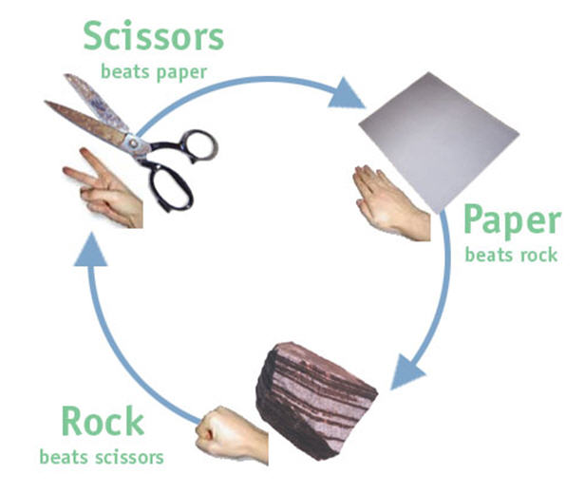
Strings Exercise - work in pairs
Consider the rules for the game of rock-paper-scissors: two players (A and B) play the game and decide their moves. You have to write a function that checks who won. Use a variable to hold the move for each player; rock will be represented by the string “R”, “P” for paper and “S” for scissors.
The function should take 2 strings (each of 1 character) in input and return a number:
=> 0 for a tie
=> 1 if A is the winner
=> 2 if B is the winner
See file rockPaperScissors.html
(Finally: What if I want to represent 3 games with 1 string?)

Slide 8
Arrays
Declare: var a = [];
Set and get values: a[3] = 5; and b = a[3];
See example02_1.html
Access a properties => 2 notations: value.x VS value[x]
When using a dot, the part after the dot must be a valid variable name, and it directly names the property
When using square brackets, the expression between the brackets is evaluated to get the property name
Example:
value.length is the same as value["length"]
but this would work: value[2] and value["John Doe"] while the dot notation would not!

Slide 9
Arrays
“The elements in an array are stored in properties.
Because the names of these properties are numbers and we often need to get their name from a variable, we have to use the bracket syntax to access them” [ELO chpt 4]
-> array.length is easier to write than array["length"]
Array methods:
A property can be any value, some properties are functions
“Properties that contain functions are generally called methods of the value they belong to” [ELO]
examples: toString, push, pop, join, indexOf
See example02_2.html

Slide 10
Heterogeneous and nested arrays (for data modeling)
heterogenoeus arrays: elements are of different type
see example02_3.html
1 element of an array can be even another array! (nested arrays)
Using arrays to model data. Example: A person has many dogs, each dog has a name and a breed. There are many people, and each person has a name and a birthday.
var aDog = ["fido","cocker"];
var aPerson = ["Andrea",[27,08], [ aDog ] ];
var people = [ aPerson, ["Alex",[21,12], [ ["fuffi","terrier"],["bob","boxer"] ] ] ];
How to access and process the data in these nested arrays?
see example02_4.html
before Object-Orientation this was a common way to model data

Slide 11

Arrays - exercise -
Work in pairs on a copy of the file
example02_4.html
A) Change the code to represent the fact that each dog has a weight in kilograms:
fido weights 22 kg
fuffi weights 34 kg
and bob weights 18 kg
assign each dog in your array its own weight.
B) Change the inner for loop to print the weight of each dog, together with their name and breed

Slide 12
Objects
“Values of the type object are arbitrary collections of properties, and we can add or remove these properties as we please.” [ELO chpt 4]
Declare/initialize an object
Add and remove properties
What about non-existing properties?
See example03_1.html
Mutability -> aliasing or “2 variables referring to the same object” example03_2.html
JavaScript’s == operator, when comparing objects, will return true only if both objects are precisely the same piece of data in the memory

Slide 13
Objects
typeof operator -> example03_3.html
Initialize and apply functions to objects
a banana has a color and a price: I use an object to model a banana, and a few functions to print and modify the bananas in my program -> example03_4.html

Slide 14
Objects as maps
“Objects can also serve as maps, associating values with names. The in operator can be used to find out whether an object contains a property with a given name. The same keyword can also be used in a for loop (for (var name in object)) to loop over an object’s properties.” [ELO]
See example03_5.html
Note: this program uses the for-in statement http://www.w3schools.com/jsref/jsref_forin.asp
How would you add the new pair “hi”,”ciao” to the dictionary?

Slide 15
Modeling and processing data
Arrays of objects -> see ELO squirrel example:
example04_1.html
example04_2.html
A simpler example: an array of car objects
example04_3.html

Slide 16
Today’s task
Work in pairs on QuizzesTask (folder 05 quizzes_task)

Slide 17

Next lecture
finish today’s task
Read from book: "Responsive Web Design with jQuery"
chapters 1,2 and 3
(and we will only cover the intro of chapters 4 and 5)

